Slide 1
Hayter1993 Data Analysis Results!!!!
Hayter, P. M., Curling, E. M. A., Gould, M. L., Baines, A. J., Jenkins, N., Salmon, I., … Bull, A. T. (1993). The effect of the dilution rate on CHO cell physiology and recombinant interferon‐γ production in glucose‐limited chemostat culture. Biotechnology and Bioengineering, 42(9), 1077–1085. https://doi.org/10.1002/bit.260420909

Slide 2
Medium
rpmi_1649_supplement["bovine serum albumin"] = 5; # (mg/ mL)
rpmi_1649_supplement["insuline"] = 5; # 5 μg/ mL
rpmi_1649_supplement["transferrin"] = 5; # μg/ mL
rpmi_1649_supplement["sodium pyruvate"] = 1; # mM
rpmi_1649_supplement["alanine"] = 0.1; # mM
rpmi_1649_supplement["putrescine,"] = 1; # μM
rpmi_1649_supplement["FeSO4"] = 3; # μM
rpmi_1649_supplement["ZnSO4"] = 3; # μM
rpmi_1649_supplement["Na2SeO3"] = 10; # nM
rpmi_1649_supplement["CuSO4"] = 10; # nM
rpmi_1649_supplement["Methotrexate"] = 0.1; # μM
rpmi_1649_supplement["Glucose"] = 2.75; # mM

Slide 3
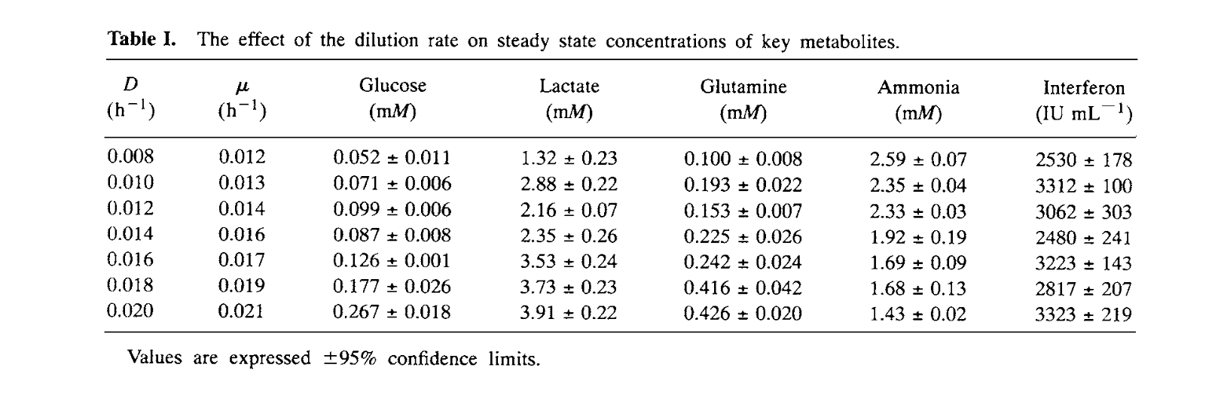
Data

Slide 4
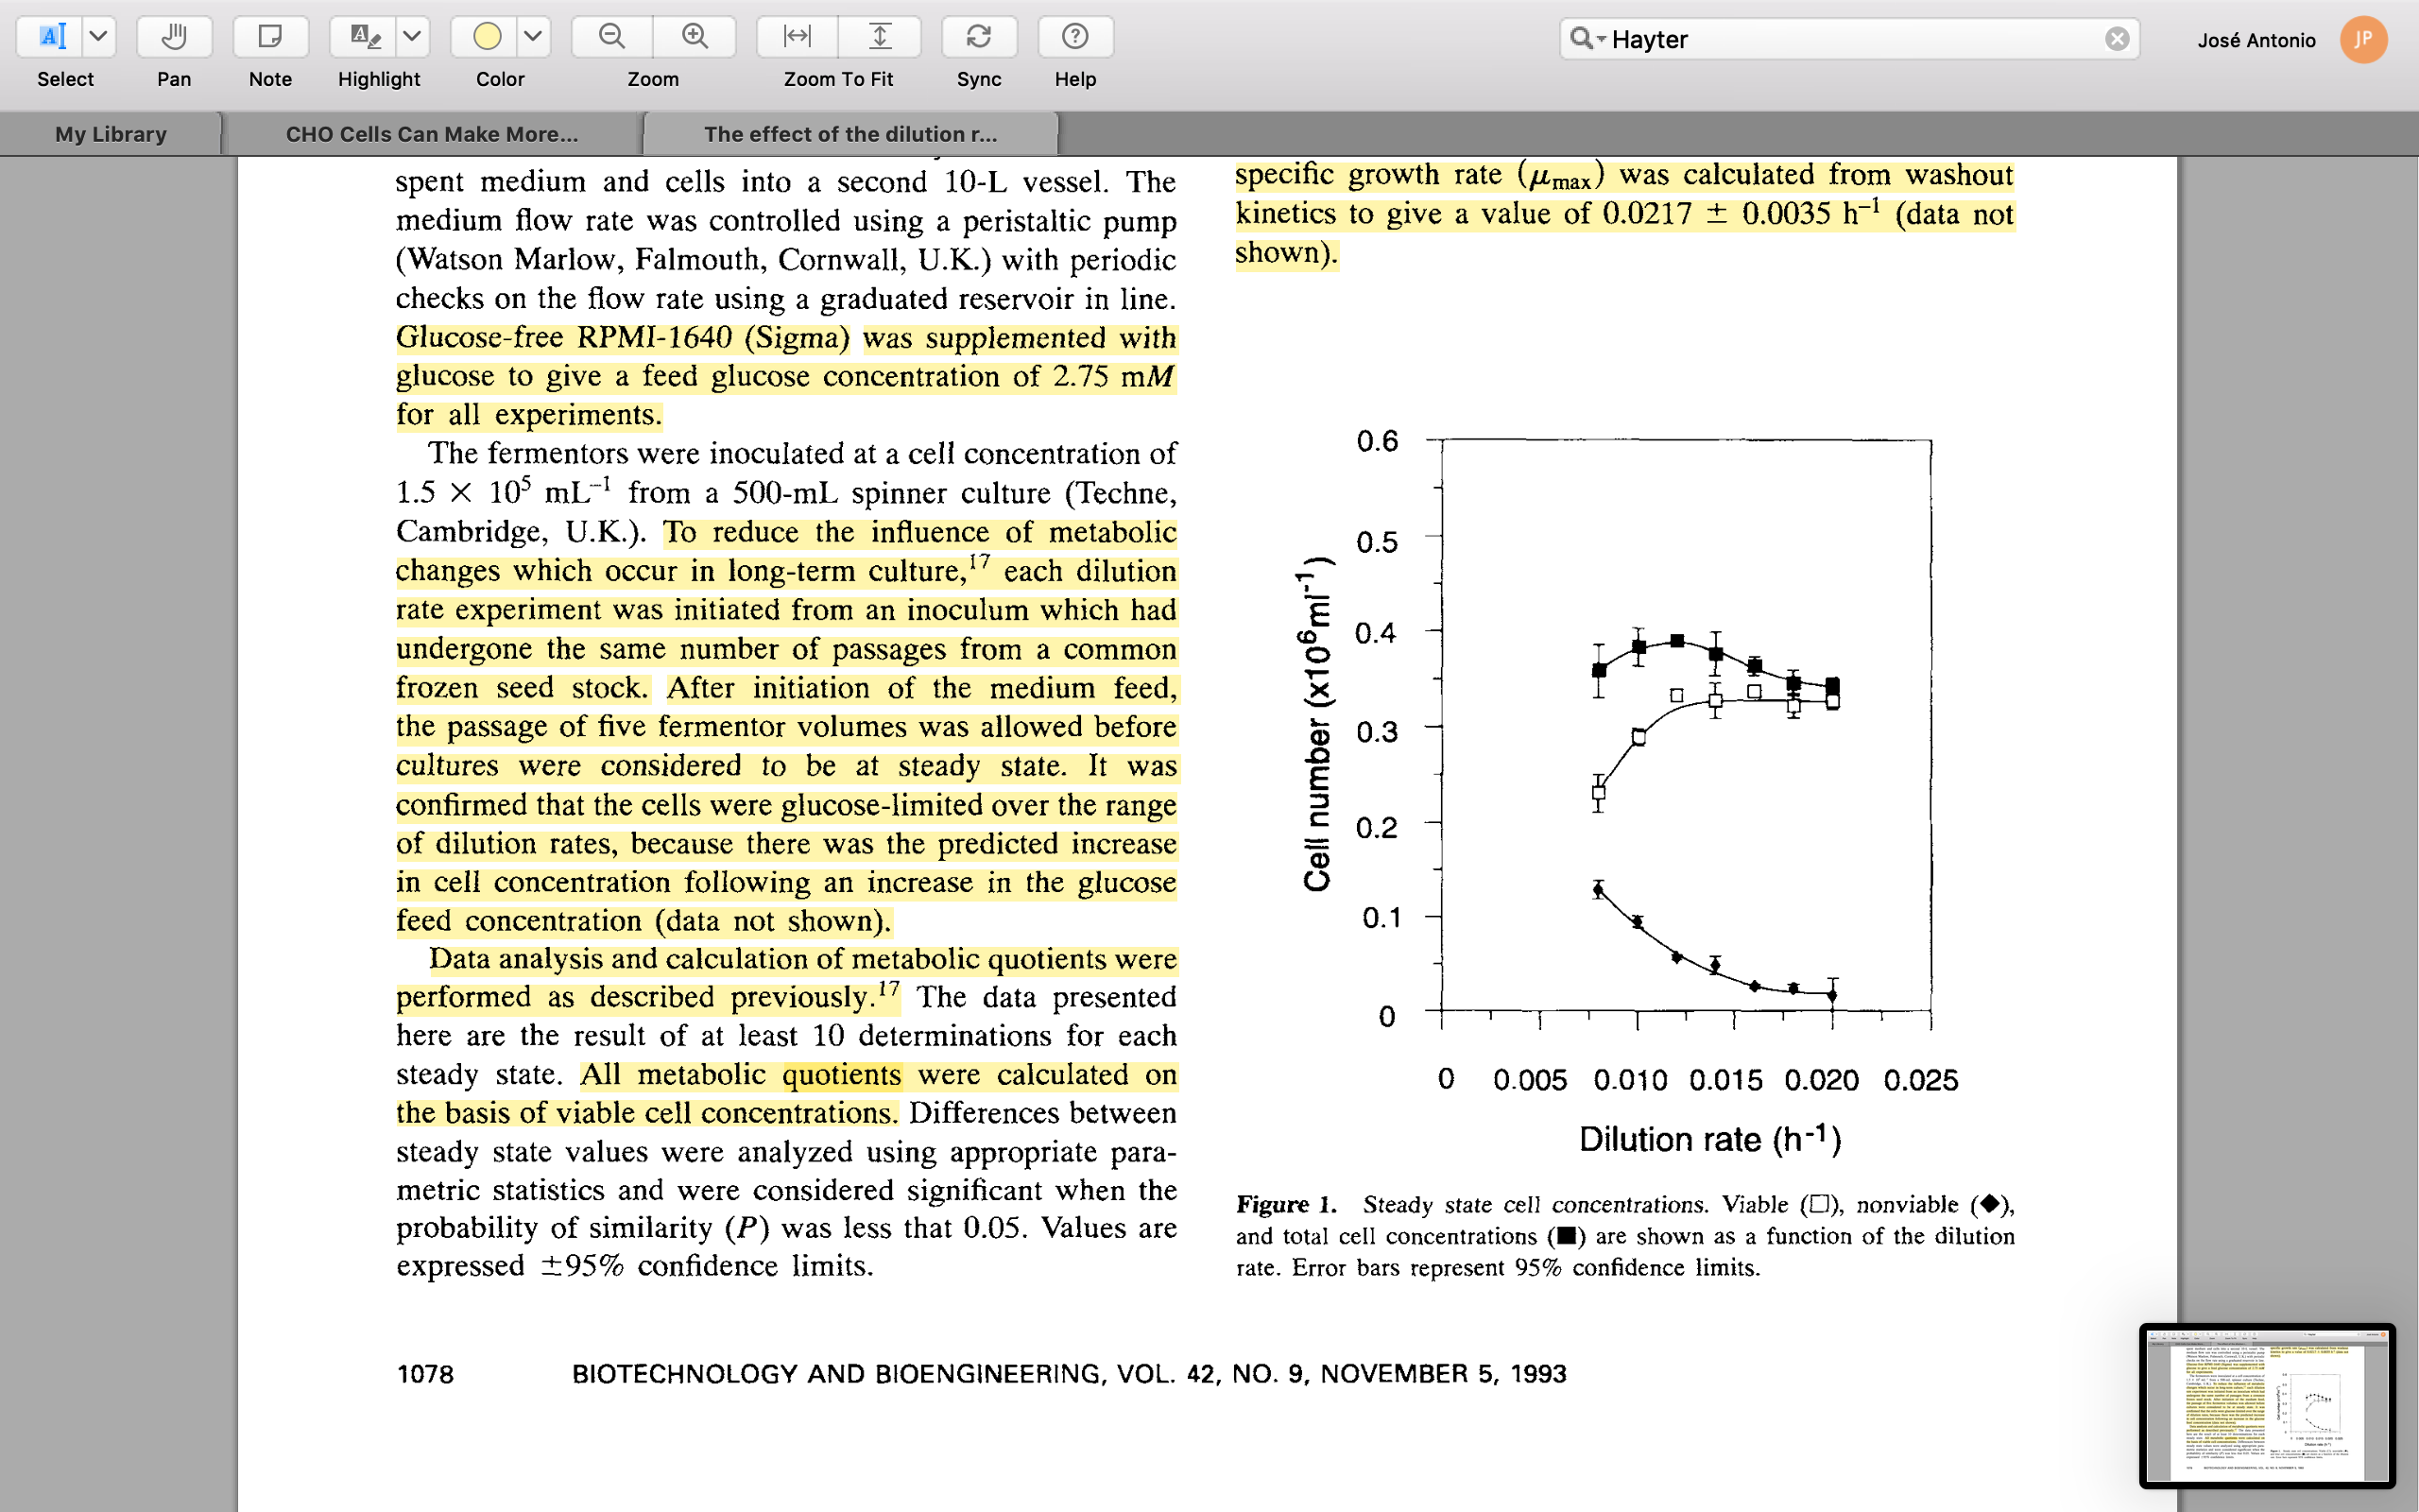
Data

Slide 5
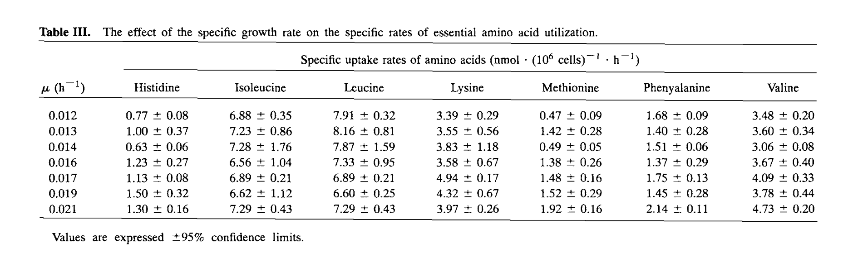
Data

Slide 6
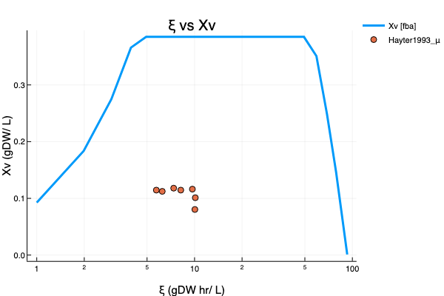
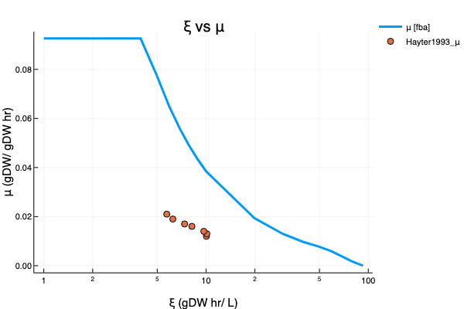
CHO Chemostat (FBA)

Slide 7
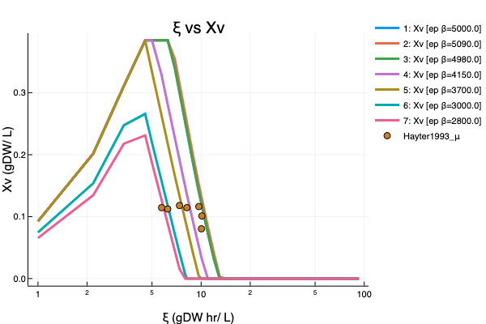
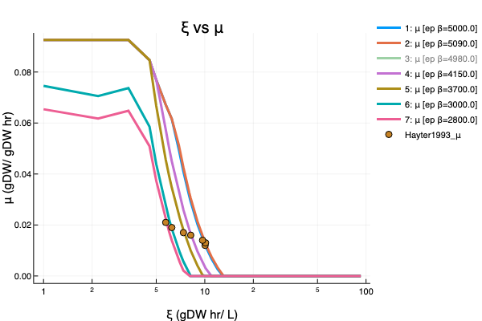
CHO Chemostat (EP)

Slide 8
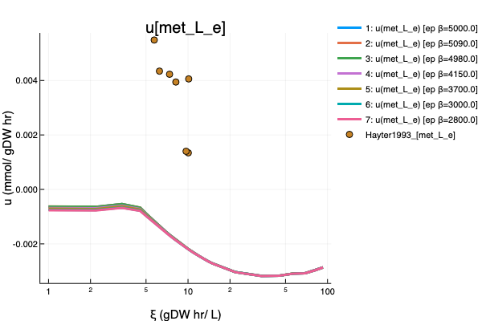
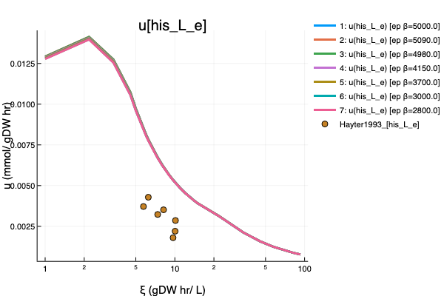
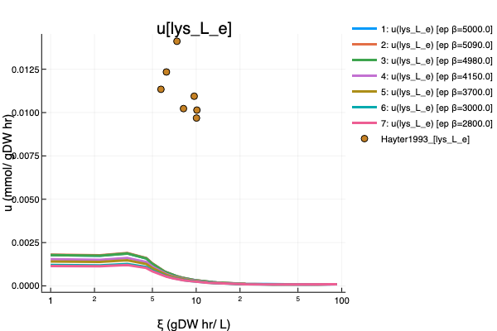
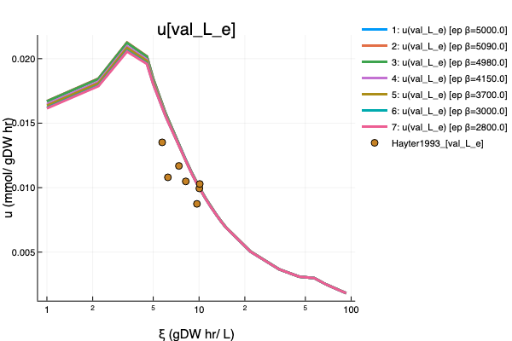
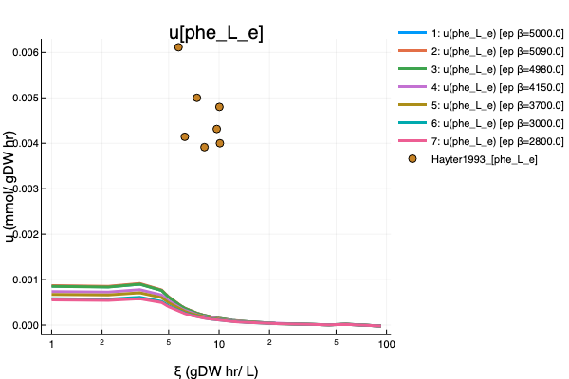
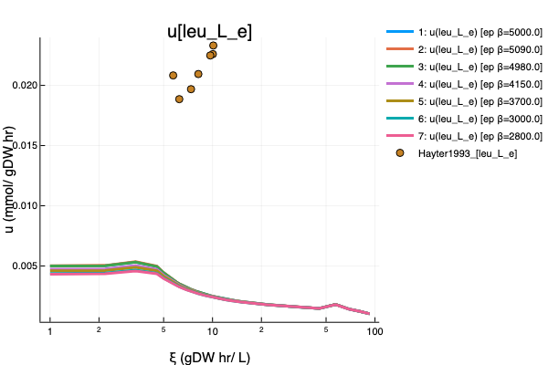
CHO Chemostat (EP)

Slide 9
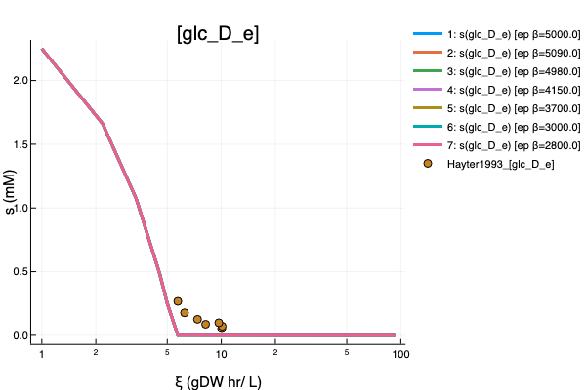
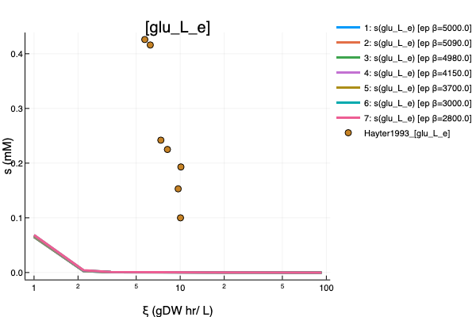
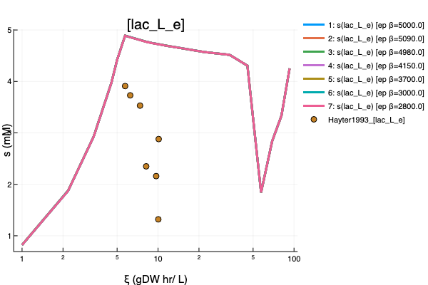
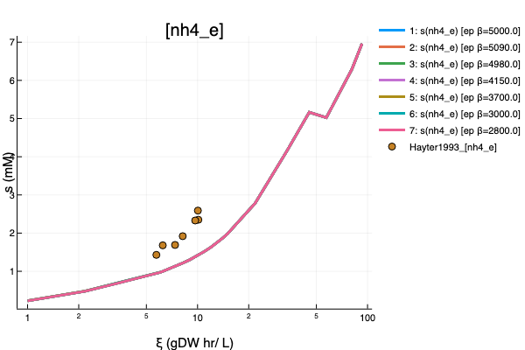
CHO Chemostat (EP)

Slide 10
Causes!!!
Unappropriated Network
From the beginning, the used networks wasn’t specific for the cell lines used in the experiments.
The networks are unable to reproduce phenotypic features of the experimental cell lines.

Slide 11
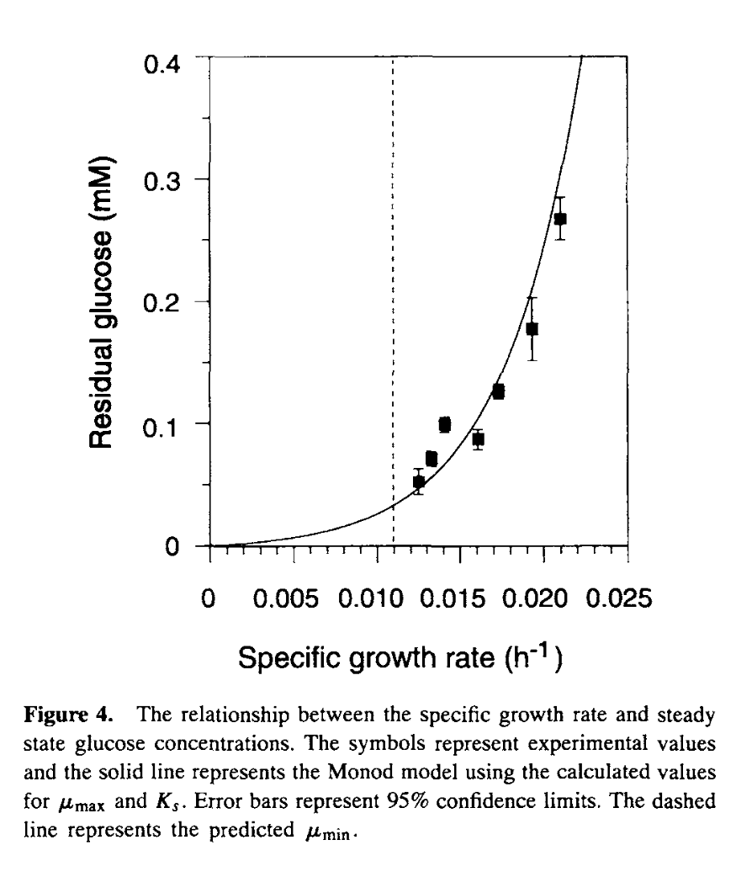
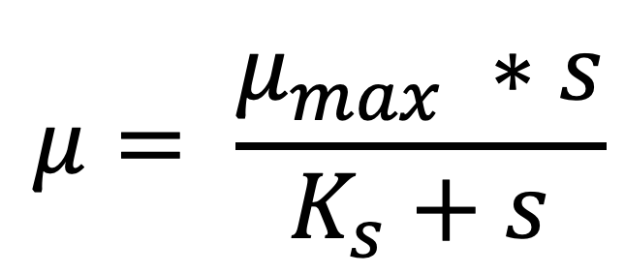
Glucose-Limited culture
Hayter1993
$$μ= \frac{μ_{max} ∗s}{K_{s}+s}$$

Slide 12
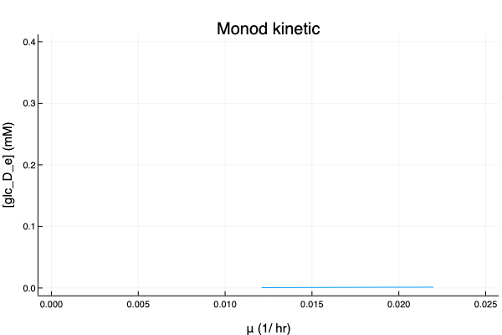
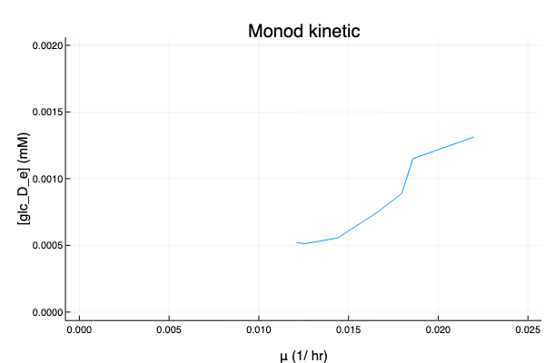
Glucose-Limited culture (CHO-EP)

Slide 13
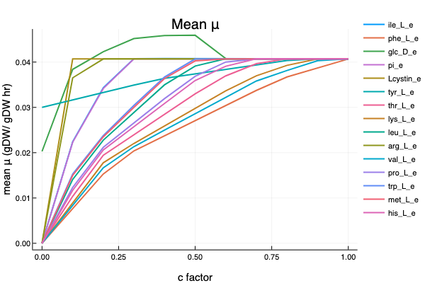
Substrate-Limited study (CHO)

Slide 14
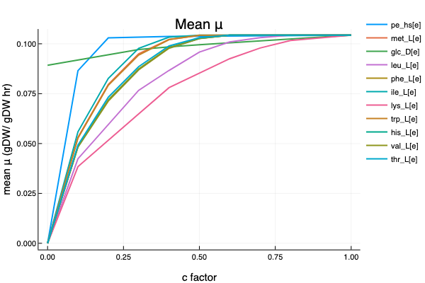


Substrate-Limited study (Recon3)

Slide 15
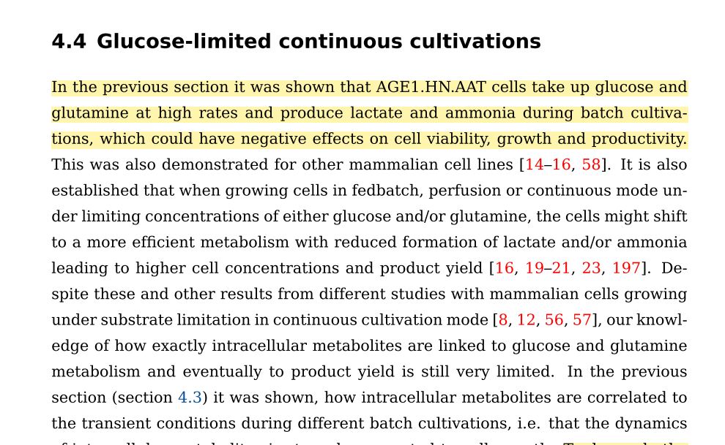
Rath2017

